Slide 1
Together, We Make Our Lives Simpler

Slide 2


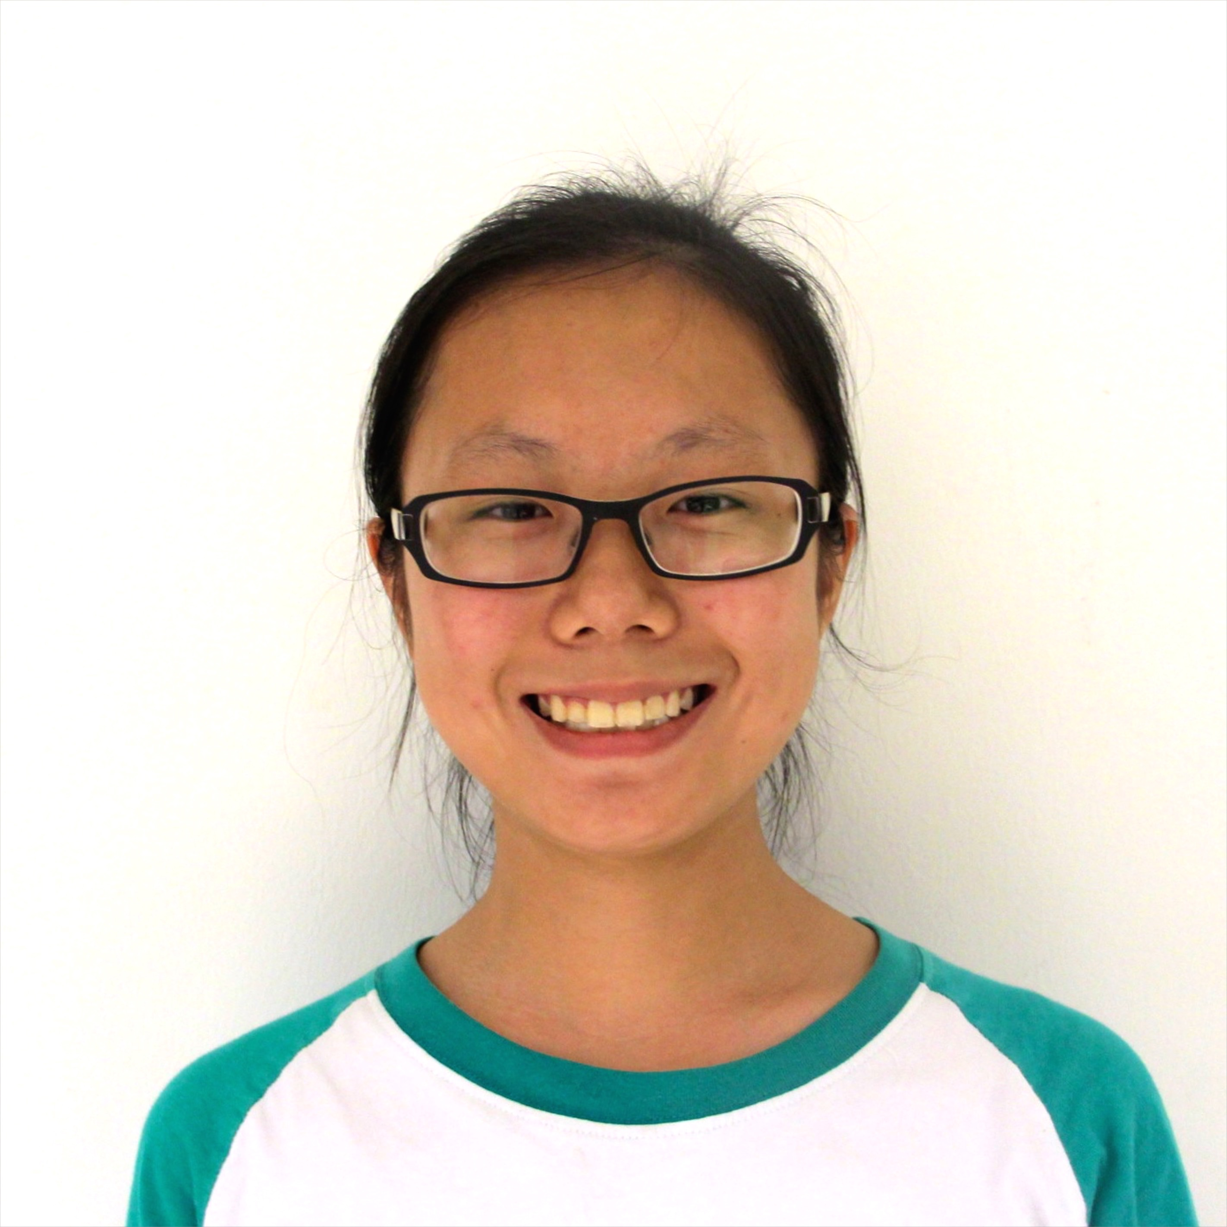
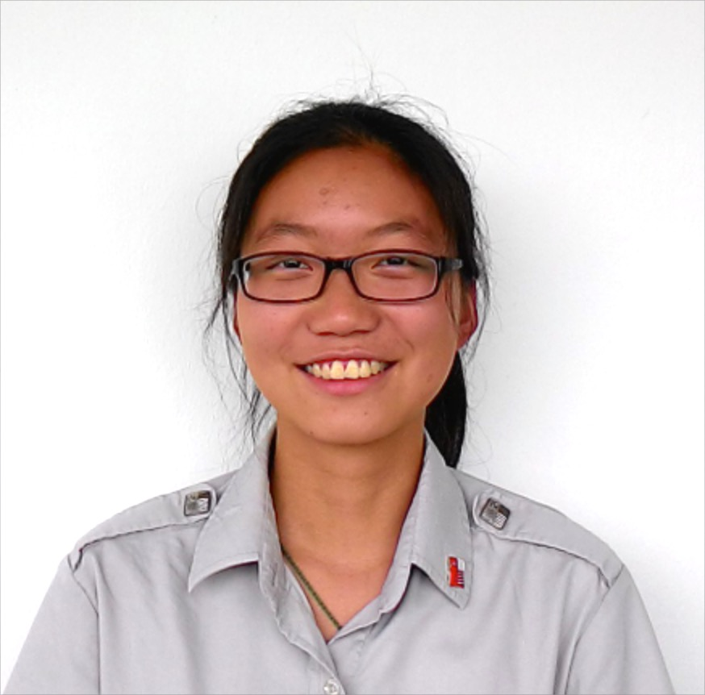
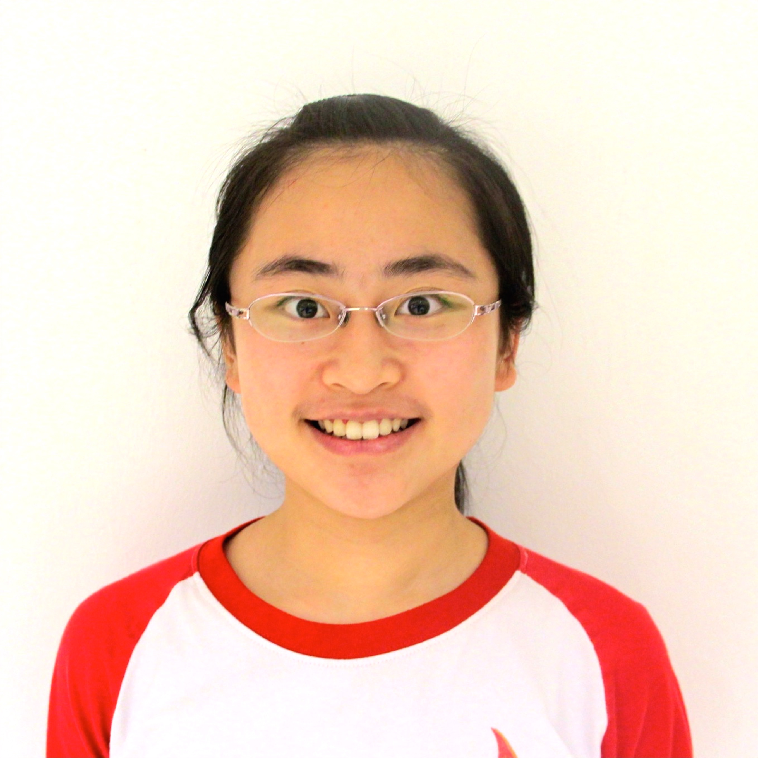
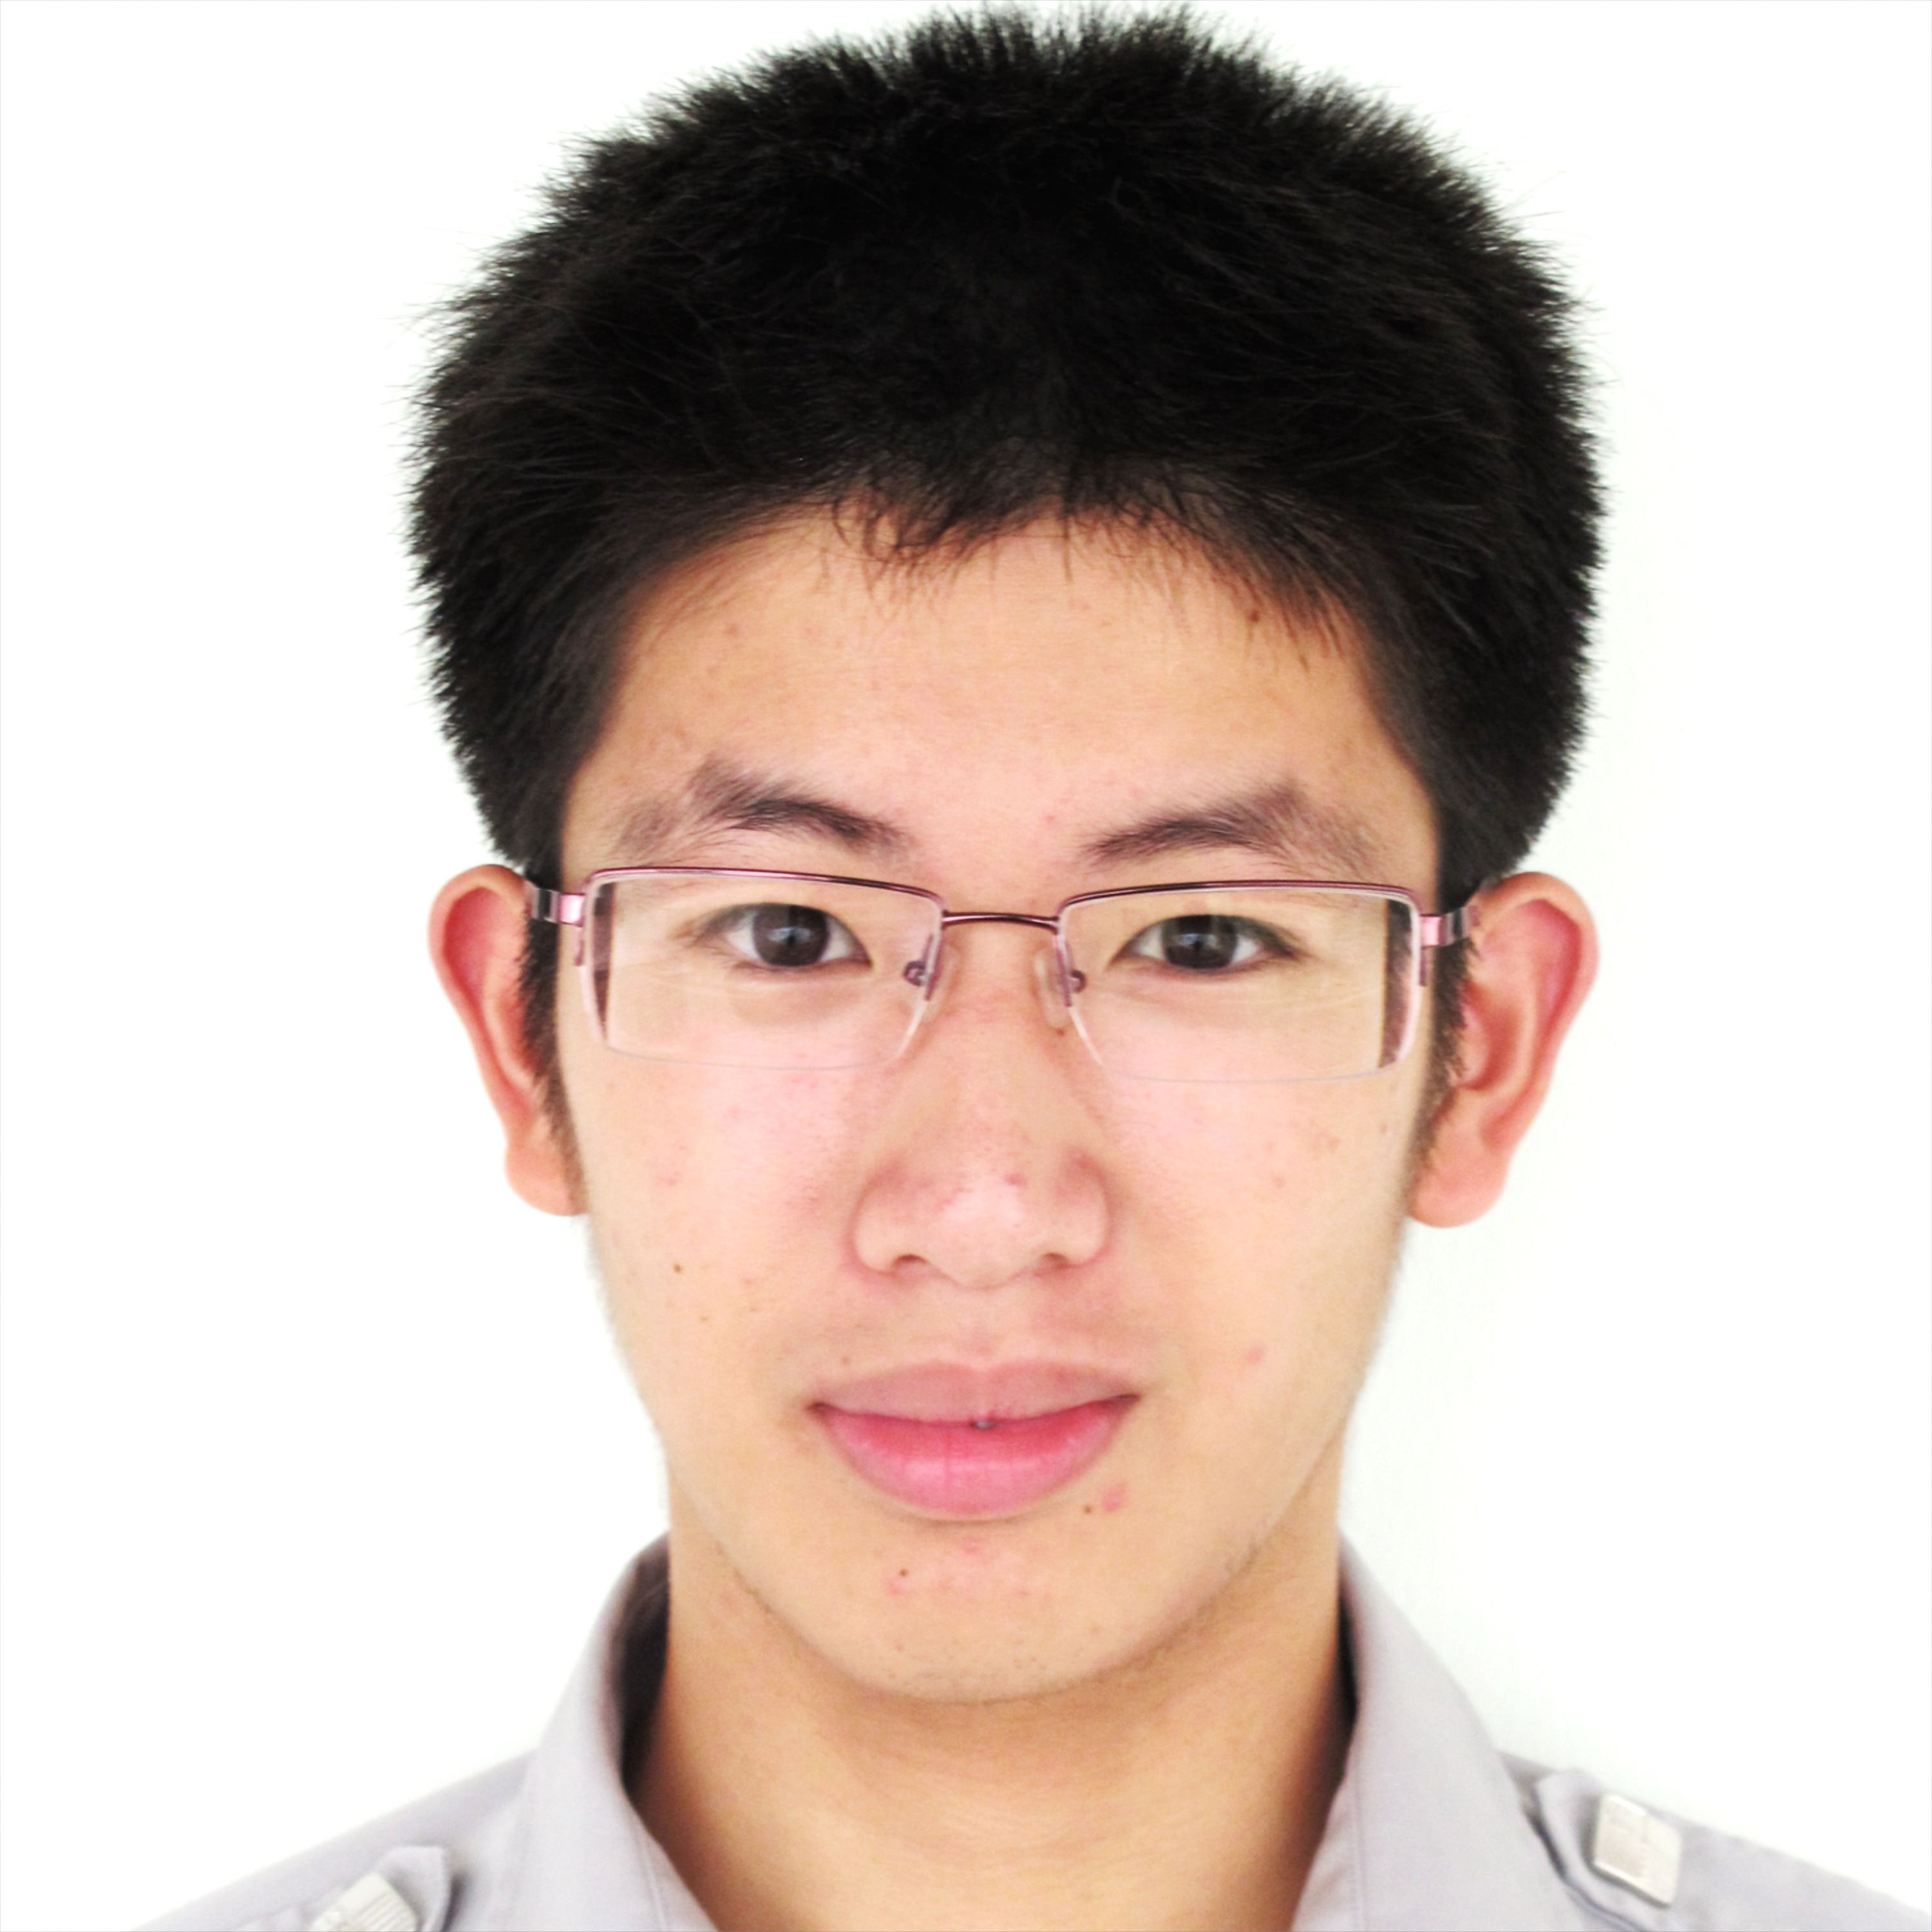
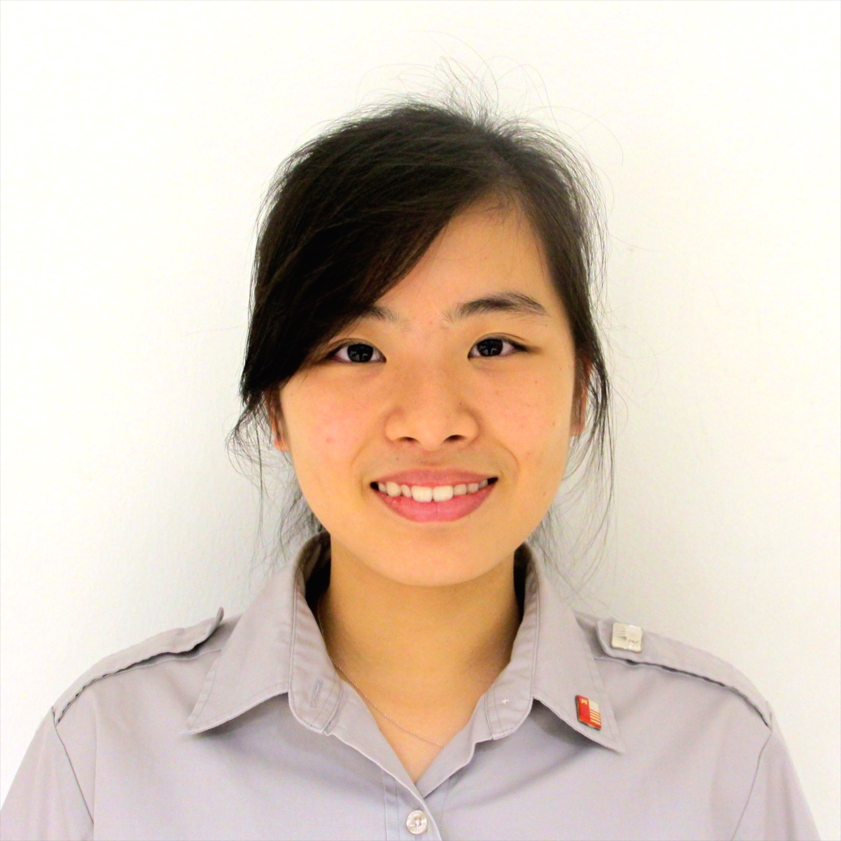
Our team
Lu Yuan
Sun Lu
Shi Meng
Liao Liang
Jia min

Slide 3






Overview
Customer
Acquisition
Future Expansion
Innovation
Financials

Slide 4


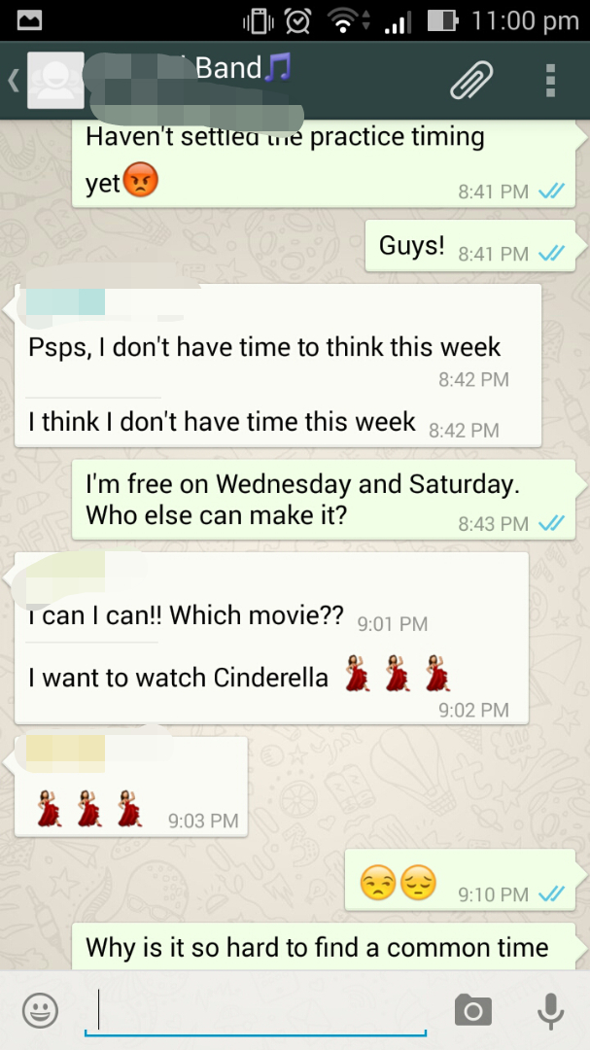
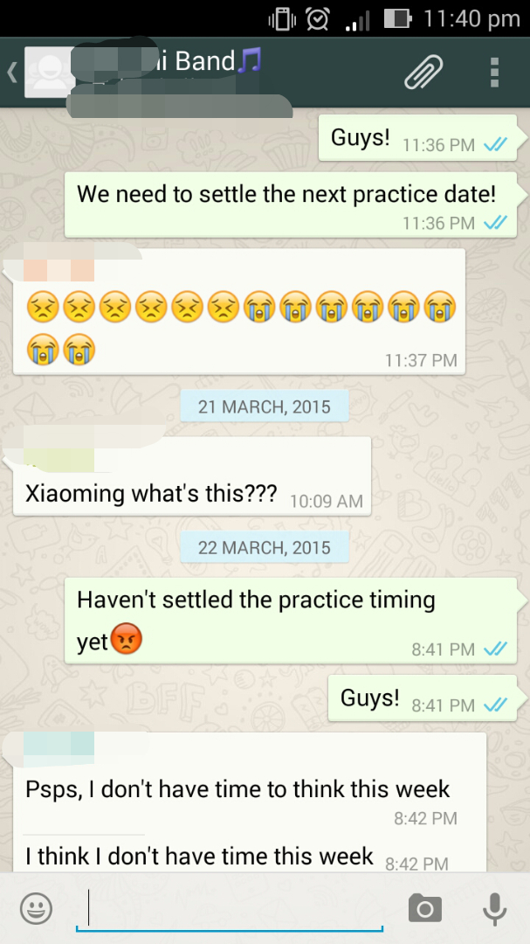







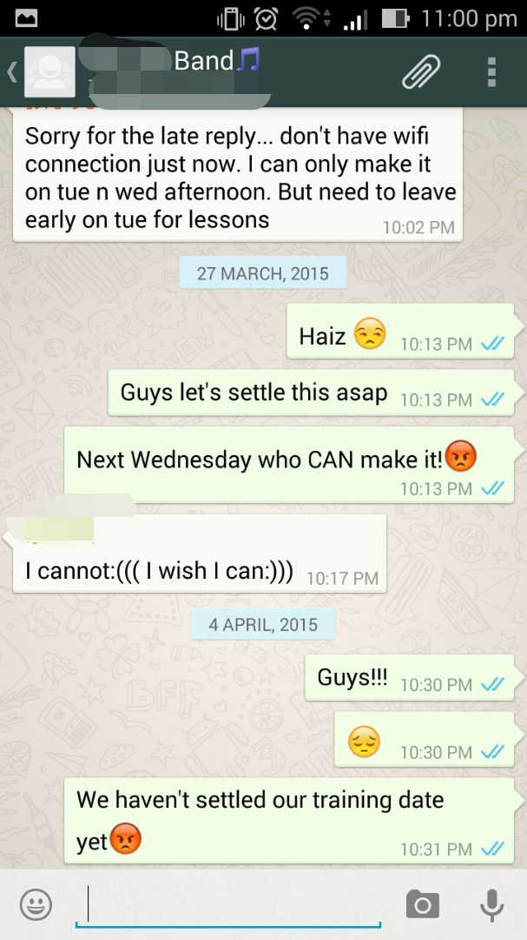
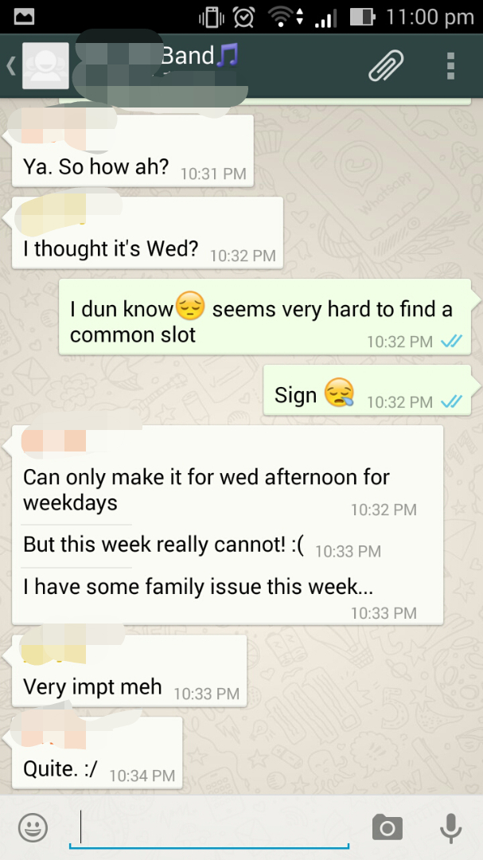
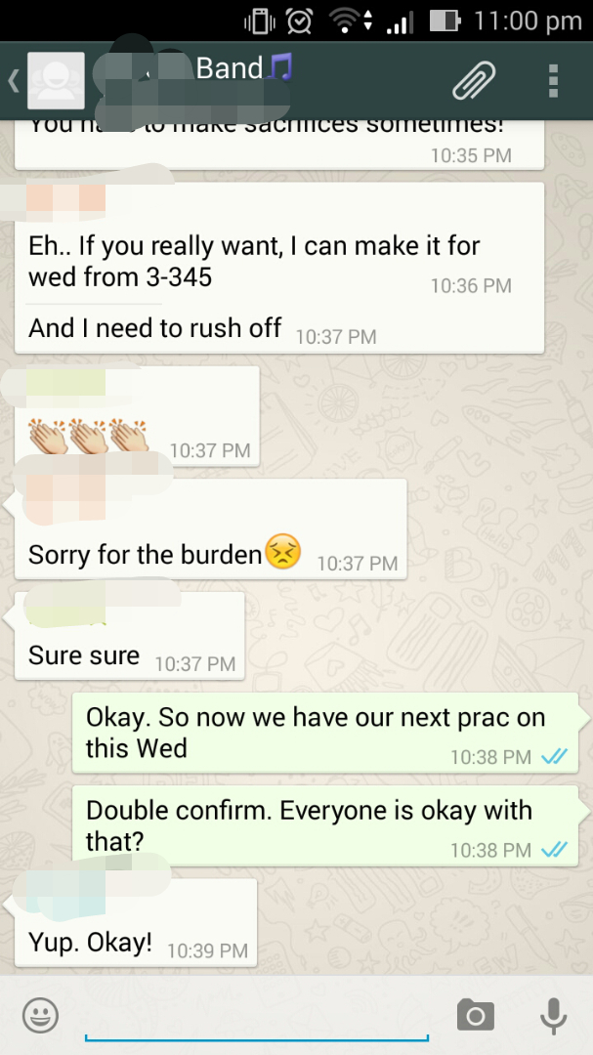
Pain
<
>
T
T
^
35 min
on average
Innovation
Customer Acquisition
Financials
Future Expansion

Slide 5

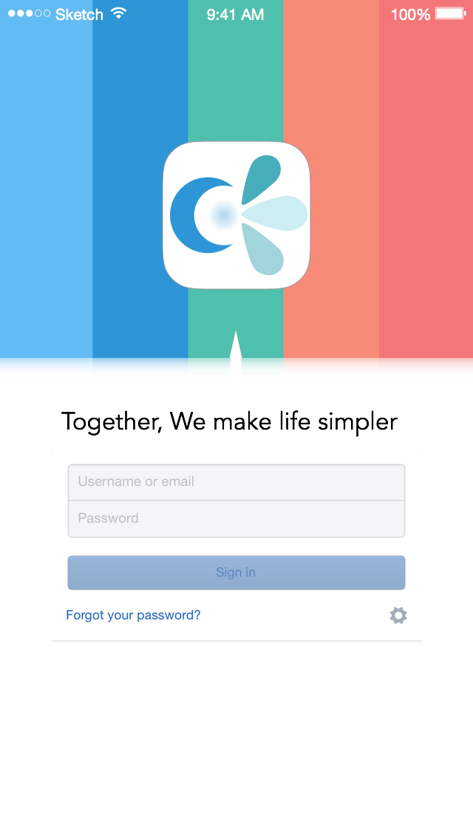

Our Solution:
Our Solution: Clan°dar
C
a
l
e
n
°
dar
Login in with school email account
Clan°dar is an event/task management innovation that resolves miscommunication and inefficiency in managing group activities
wangxiaoming@gmail.com
•••••
Login in

Slide 6




Task Manager
Add
More
New task
New event
Cancel

Slide 7
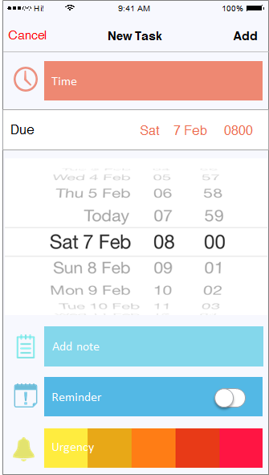

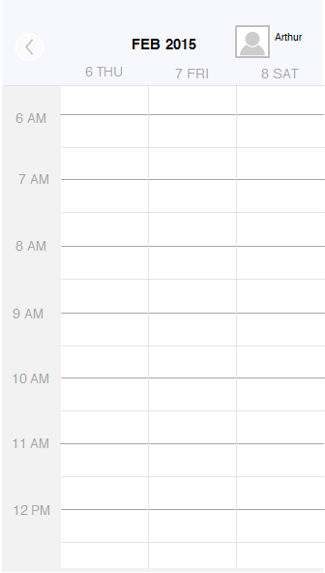







Task Manager
Semi Final presentation
Semi Finalpresentation
Semifinal
Semi Final presentation
Semi Final presentation
2359 10 Apr Fri
CCA
JIAYOU ONE MORE DAY!
YIC Ideal Gas

Slide 8
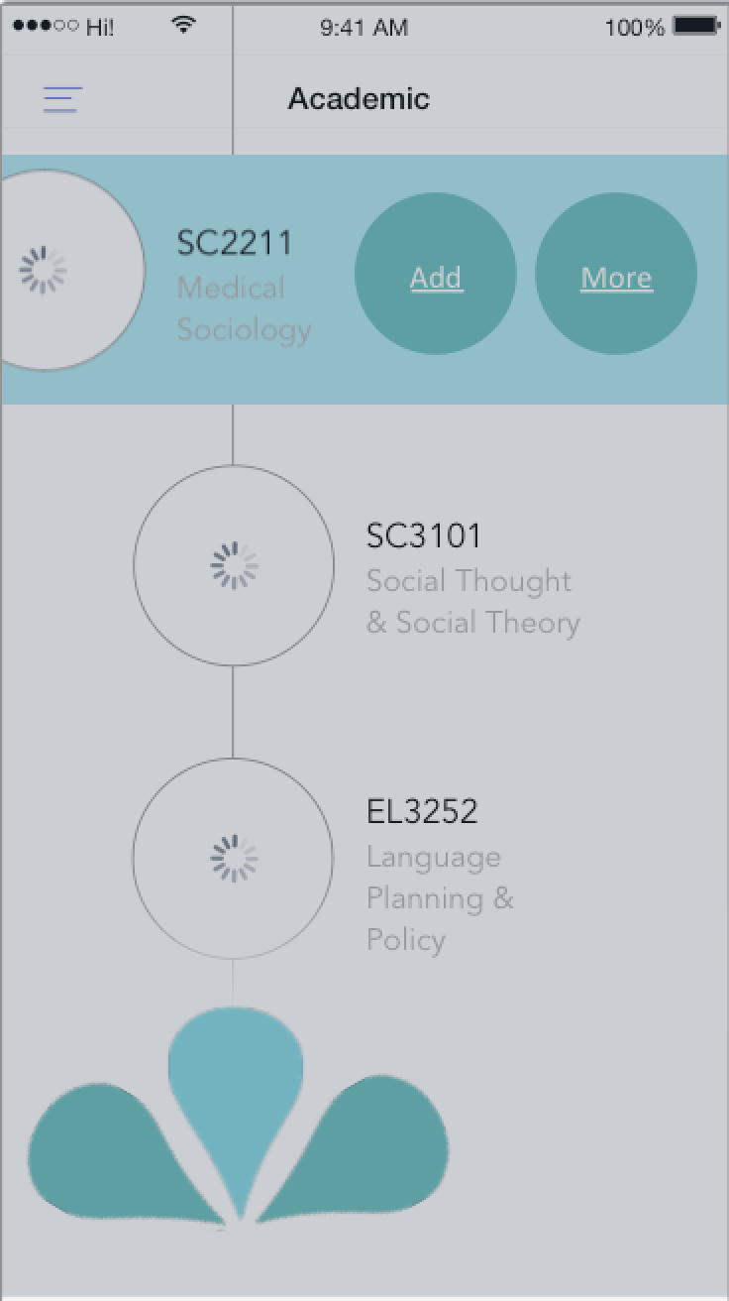
Event Manager
New task
New event
Cancel

Slide 9









Event Manager
Cancel
New Event
Add
Members
Time
Location
Add note
Urgency

Slide 10


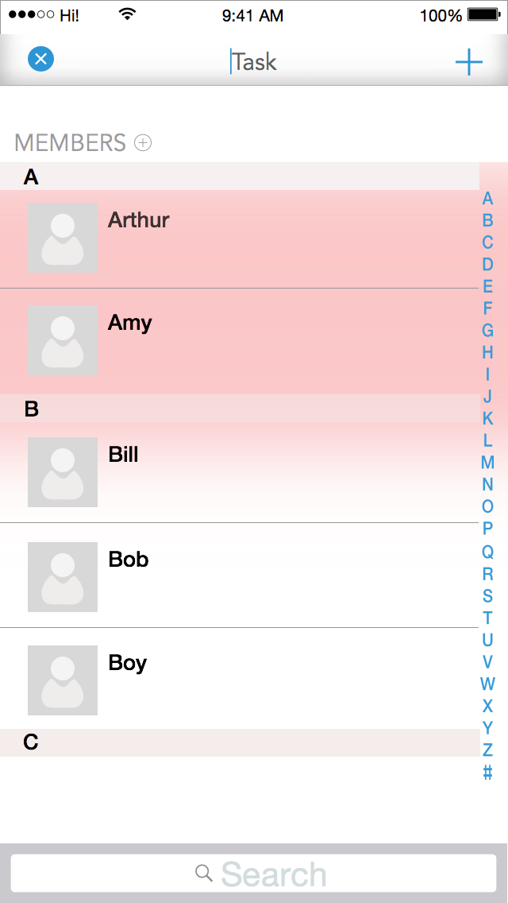
Event Manager
Cancel
Add Members
Add
All Members
A
Arthur
Annabelle
B
Bernard
Benedict
C
Cassandra
Search

Slide 11
Event Manager
Cancel
Add Time
Add
APR 2015
9 THU
10 FRI
11 SAT
1 PM
Common time slots are
auto-generated by the system
2 PM
3 PM
4 PM
5 PM
6 PM

Slide 12
Event Manager
Cancel
New Event
Add
Members
Time
NO COMMON TIME SLOTS ARE FROUND!
Would you like to access members’ time tables?
Location
Yes
Nvm
Add note
Urgency

Slide 13
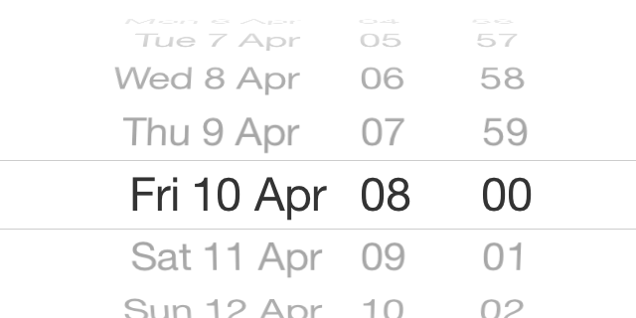
Event Manager
Cancel
Extra practice
Add
All members
Time
Start
Fri 10 Apr 1200
End
Fri 10 Apr 1400
Unavailable Members
Arthur
Arthur’s Calendar

Slide 14
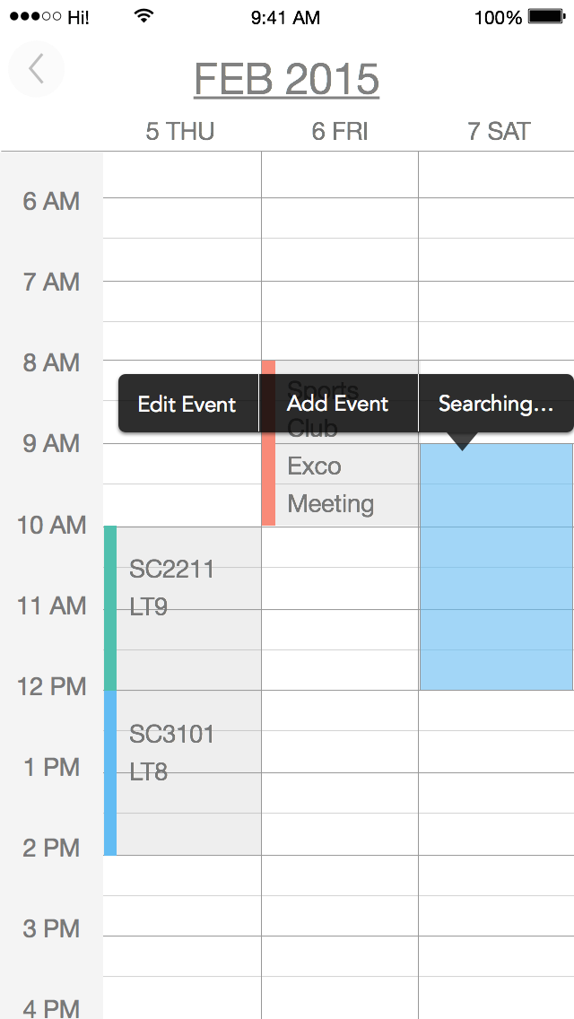
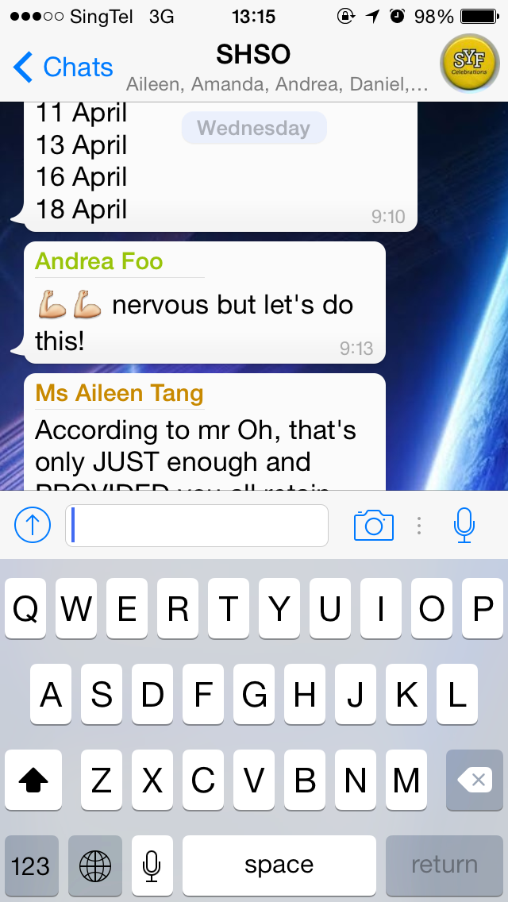
Event Manager
Arthur
APR 2015
9 THU
10 FRI
11 SAT
12 PM
Tuition
1 PM
2 PM
Family Matter
Tuition
3 PM
4 PM
Chat Room
5 PM
6 PM

Slide 15
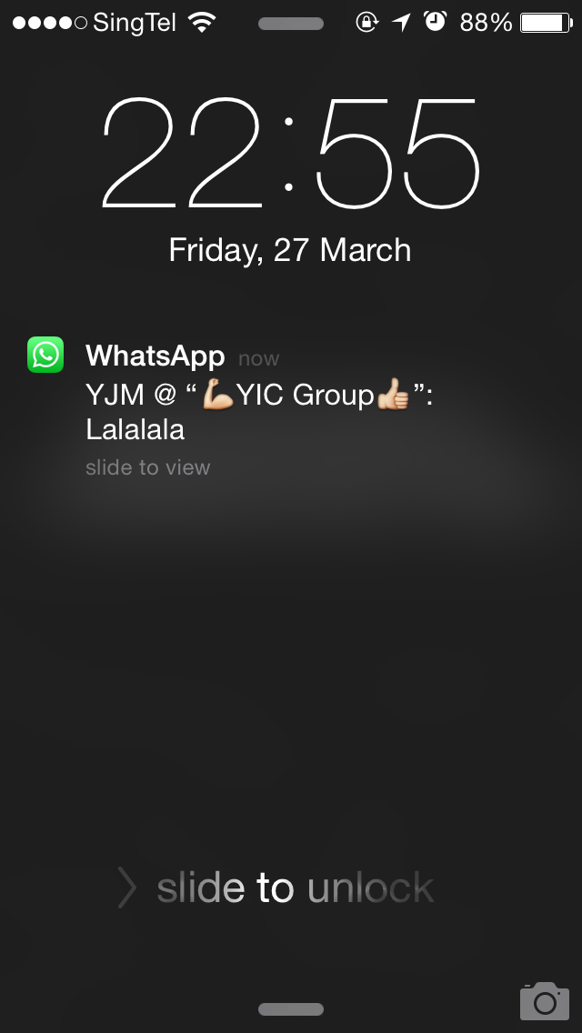



City of Honour
Game
!
!
Clan°dar
Time for construction!

Slide 16


City of Honour
Game
←
Today’s Check List
Math hw
Quantum Physics
Electrochem tutorials
ECA self prac

Slide 17


City of Honour
Game

Slide 18



External Event
Searcher
+
APR 2015
Would you like to…
9 THU
FRI
WED
THU
10 FRI
11 SAT
SAT
SUN
12 PM
Recommended
SC3101
LEC [1]
LT8
ECA Meeting
Dialogue with leaders in Social…
1 PM
Add Event
Add Task
Searching…
SMU Open House 2015
Academic
YIC final presentation invitation…
2 PM
SPF career talk
3 PM
Extra-Curricular Activities
Volunteer
External Events
Sea game volunteers
4 PM
Internship
SC2211
TUT [D4]
AS 1-0208
Social Media Internship
5 PM
Business Development Intern
6 PM
Search
Notes:
Final

Slide 19
Clan°dar
APR 2015
9 THU
10 FRI
11 SAT
12 PM
Deadline of Tasks
New group activities
1 PM
ECA
Meeting
2 PM
Workshop
Extra practice
3 PM
New group activities
School Curriculum
Time Table
4 PM
5 PM
SC2211 TUT [D4]
1S205
6 PM
Tuition
7 PM
Hangouts
8 PM
CM1021 TUT [D4]
1S205
9 PM
10 PM
11 PM
12 PM

Slide 20

Customer Acquisition (Plan A)
Offer local universities a
3-month free trail
Innovation
Customer Acquisition
Financials
Future Expansion

Slide 21
Customer Acquisition (Plan B)
Special Offer
Discount
Different Activity Groups
Publicize our app during the activity
Innovation
Customer Acquisition
Financials
Future Expansion

Slide 22


Customer Acquisition (Plan C)
Innovation
Customer Acquisition
Financials
Future Expansion

Slide 23
Pricing Table
Freemium
Buy in Bulk
Pay by Pax
Trial package
Standard package
University package
FREE
S$4.99
S$0.99
S$1.99
S$10.00
S$2.49
S$3.99
No. of Clans
No. of Clans
No. of Clans
3
+5
unlimited
+1
+3
Max No. of members
Max No. of members
Max No. of members
50
50
20
unlimited
100
Innovation
Customer Acquisition
Financials
Future Expansion

Slide 24
Revenue strategies
Agree
Gain Contract from Universities
Various Advertisement Modes
Innovation
Customer Acquisition
Financials
Future Expansion
Notes:
2 revenue strategies
University
External event

Slide 25
External Event
Searcher
+
APR 2015
Would you like to…
9 THU
10 FRI
11 SAT
12 PM
Recommended
SC3101
LEC [1]
LT8
ECA Meeting
Dialogue with leaders in Social…
Add Event
Add Task
Searching…
Publicize external events
1 PM
SMU Open House 2015
YIC final presentation invitation…
2 PM
SPF career talk
3 PM
Volunteer
Sea game volunteers
4 PM
Internship
SC2211
TUT [D4]
AS 1-0208
Social Media Internship
5 PM
Business Development Intern
6 PM
Search
Notes:
Final

Slide 26

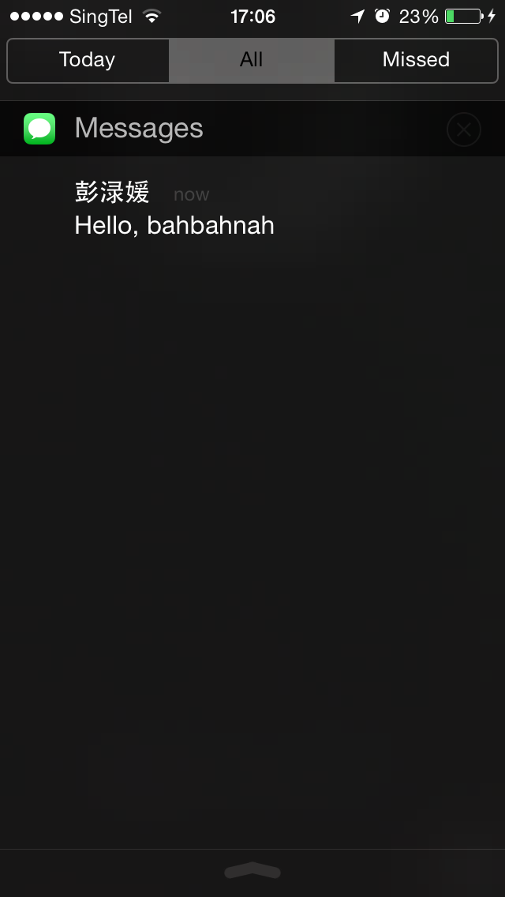

Advertisement
+
APR 2015
WED
THU
FRI
SAT
SUN
9 THU
10 FRI
11 SAT
Clan°dar
12 PM
SC3101
LEC [1]
LT8
ECA Meeting
Clan°dar now
External Event- Dialogue With Leaders In Social Work Practice
1 PM
!
Academic
!
2 PM
Dialogue with Leaders
in Social Work Place
+
Extra-Curricula Activities
External Events
3 PM
1PM 11 Apr Sat to
4PM 11 Apr Sat
4 PM
SC2211
TUT [D4]
AS 1-0208
CCA
5 PM
You are invited to a sharing session to hear stories and insights on Social Work practice from veterans in the…
6 PM
Notes:
Push service
Buffer
Today’s best

Slide 27
Annual Revenue
In-App Purchase Revenue
Advertisement Revenue
2016
90.6%
9.4%
$254,000
2017
86.5%
13.5%
$532,000
2018
93.5%
6.5%
$738,000
Innovation
Customer Acquisition
Financials
Future Expansion

Slide 28




Budget (S$)
161000
App Development
Maintenance
27000
60000
60000
21000
50000
60000
Marketing
50000
180000
10000
160000
160000
Human
Capital
Year 1
Year 2
Year 3
Innovation
Customer Acquisition
Financials
Future Expansion

Slide 29
Profits (S$)
-197,000
38,000
525,000
Innovation
Customer Acquisition
Financials
Future Expansion
Notes:
Revenue + budget(cost)

Slide 30
Timeline
1ST May
1ST June
Affiliate Marketing
2015
30th June
1ST May
1st July
Completion of Calendar
Sign Contract with Universities
Innovation
Customer Acquisition
Financials
Future Expansion
Notes:
Revenue + budget(cost)

Slide 31

Timeline
Negotiate with Clients for in-app advertisement
Sign contracts with other universities
Launch the app
2016
1ST June
1ST July
1ST Jan
Innovation
Customer Acquisition
Financials
Future Expansion
Notes:
Revenue + budget(cost)

Slide 32

Timeline
App development in preparation for internationalization
Launching of app in China
2016
2017
1ST Jan
1ST Jan
Innovation
Customer Acquisition
Financials
Future Expansion
Notes:
Revenue + budget(cost)

Slide 33


Future Expansion
Partner Development
Internationalization
Innovation
Customer Acquisition
Financials
Future Expansion

Slide 34

Internationalization
Increasing smartphone penetration
Huge student population
Niche market
Innovation
Customer Acquisition
Financials
Future Expansion

Slide 35
Market Analysis of China
How much time do you think has been wasted in organizing group activity?
Innovation
Customer Acquisition
Financials
Future Expansion

Slide 36








Competitive Position in China
Friday
Clan°dar
ClassBox
Academics
Activities
Our product
Financials
Customer Acquisition
Future Expansion
Notes:
35.03%
38.42%

Slide 37

Market Analysis of China
24,700,000
Pain
Solution
Differentiation
Scalability

Slide 38
Market Analysis of China
How much would you like to pay for an app that solves all above problems?
Innovation
Customer Acquisition
Financials
Future Expansion

Slide 39
Operational Plan
App development & testing
Launch in Beijing & Shanghai
Expand the market to other regions
Innovation
Customer Acquisition
Financials
Future Expansion

Slide 40
Partner Development
WED
THU
FRI
SAT
SUN
Other organizations:
NGOs
Government
Private companies
Co-workers
Academic
Extra-Curricula Activities
External Events
Family
Friends
Innovation
Customer Acquisition
Financials
Future Expansion

Slide 41
Address clear, unmet, large market demand
Strong, competitive, unique selling points
Why Clan°dar?
Opportunity for future diversification and growth
Significant, sustained financial returns on investment
Passionate, dedicated team

Slide 42
Together, We Make Our Lives Simpler

